Slide 1
STOCK PRICE PREDICTION WITH MACHINE LEARNING USING PYTHON
BY : HRIDAYA TAYADE

Slide 2
PREDICTING STOCK PRICES
Why Stock Prices are Challenging to Predict
1. High Volatility and Noise
Stock prices are influenced by a chaotic mix of variables, ranging from global political shifts and interest rate changes to sudden social media trends. This creates "noise"—short-term price fluctuations that don't follow a clear trend. Unlike a physics experiment where variables are controlled, market volatility is often driven by human emotion (fear and greed), which is notoriously difficult to quantify.
2. Non-Linear Patterns
Traditional math often looks for "linear" relationships—where if X happens, Y follows in a straight line. However, the stock market is non-linear. A small change in a company’s earnings might cause a massive crash one day, but have zero impact the next, depending on the broader economic context.
3. The Efficient Market Hypothesis (EMH)
There is also the challenge of the "Efficient Market." This theory suggests that all known information is already reflected in a stock's price. Therefore, to predict the future price, you must predict new information that hasn't happened yet.
ML vs. Traditional Statistical Methods
Traditional statistical models, like ARIMA (AutoRegressive Integrated Moving Average), were the gold standard for decades. However, Machine Learning (ML) offers several advantages for modern markets:
Handling Dimensionality
Traditional statistics usually focus on a few variables (like past price and volume). In contrast, ML models—especially Neural Networks—can process thousands of data points simultaneously, including "alternative data" like news headlines, satellite imagery of retail parking lots, or sentiment analysis from financial reports.
Detecting Non-Linearity
While traditional models struggle with the "curves" of the market, ML algorithms like Random Forests or Gradient Boosting are designed to find complex, non-linear relationships. They don't assume a straight-line relationship; they look for patterns in the chaos.
Adaptability
A traditional statistical model is often "static." Once you set the formula, it stays that way until a human changes it. ML models can be designed to continually learn. As new market data comes in, the model can adjust its internal logic to account for shifting trends, making it far more resilient to sudden market changes.

Slide 3
DATA COLLECTION
1. The Data Source
Identify how you pulled the data. In the Python ecosystem for 2026, the most common methods are:
yfinance: The industry standard for free, reliable historical data from Yahoo Finance.
Alpha Vantage / Polygon.io: Professional-grade APIs (often used if you need real-time data or more precise "adjusted" prices).
pandas_datareader: A legacy but stable way to pull from multiple sources like St. Louis Fed (FRED) or Fama-French.
2. Key Features (OHLCV)
Explain that you aren't just looking at one number. A "Data Point" in stock prediction usually consists of:
Open: The price at the first trade of the day.
High & Low: The extreme volatility boundaries for that session.
Close: The final price (often the "Target Variable" we try to predict).
Adj Close: Adjusted for dividends and stock splits (essential for accurate long-term ML models).
Volume: The number of shares traded (shows the "strength" behind a price movement).

Slide 4
DATA PREPROCESSING AND FEATURES ENGINEERING
1. Handling Missing Values
Financial data occasionally has "gaps" due to holidays or technical glitches.
Method: Instead of deleting rows (which breaks the time sequence), we use Forward Fill (ffill).
Logic: This assumes the price remains the same as the last known price until a new trade occurs.
2. Data Scaling (Normalization)
Since we often use LSTMs or SVR, we must bring all values into a specific range (usually 0 to 1).
Tool: MinMaxScaler from scikit-learn.
It prevents the "Volume" feature (in millions) from over-powering the "Price" feature (in hundreds) during model training.
3. Creating Time-Series Sequences (The "Sliding Window")
ML models need to look at a "window" of the past to predict the future.
The Logic: If we want to predict tomorrow's PRICE, we feed the model the last 60 days of data.
Structure: We transform the flat table into a 3D array (Samples, Time Steps, Features).

Slide 5
FEATURE ENGINEERING
1. Trend Indicators: Moving Averages (MA)
Simple Moving Average (SMA): The average price over a specific period (e.g., 20-day or 50-day).
Why it matters: It "smooths" out daily price noise to show the underlying trend. If the current price is far above the 50-day MA, the stock might be overextended.
2. Momentum Indicators: Relative Strength Index (RSI)
Definition: A momentum oscillator that measures the speed and change of price movements.
Why it matters: It tells the model if a stock is "Overbought" (RSI > 70) or "Oversold" (RSI < 30), which are classic signals for a potential price reversal.
3. Temporal Features: Lagged Returns
Definition: The percentage change in price from $t-1$, $t-2$, or $t-7$ days ago.
Why it matters: This captures "Autocorrelation"—the tendency of yesterday's performance to influence today's behavior.

Slide 6
MODEL SELECTION
To find the best fit, we categorized our approach into three tiers of complexity:
1. Baseline: Linear Regression
The Concept: Predicts the next price point based on a linear relationship between features (like Time or Volume).
Best For: Capturing long-term upwards or downwards trends.
Weakness: It struggles with the "zig-zag" volatility of the stock market because it assumes a straight-line relationship.
2. Ensemble Learning: Random Forest
The Concept: A collection of many "Decision Trees" that vote on the final price.
Best For: Handling non-linear patterns and "feature importance" (identifying if RSI matters more than Volume).
Advantage: It is robust to outliers and doesn't require much data scaling compared to deep learning.
3. Deep Learning: LSTM (Long Short-Term Memory)
The Concept: A specialized type of Recurrent Neural Network (RNN) designed to "remember" information for long periods.
Best For: Sequential data. It remembers what happened 10 days ago and understands how that affects today.
Why we chose it: Stock prices aren't random; they are a sequence where the order of events matters.

Slide 7
MEAN ABSOLUTE ERROR[MAE] & ROOT MEAN SQUARED ERROR [RMSE]
1. Mean Absolute Error (MAE)
MAE measures the average magnitude of the errors in a set of predictions, without considering their direction (positive or negative). It is the linear average of absolute differences.
Characteristics:
Robustness: It is more robust to outliers than RMSE. Because it doesn't square the error, a single massive mistake doesn't disproportionately inflate the score.
Interpretability: The result is in the same units as the target variable (e.g., if you are predicting price in dollars, the MAE is in dollars).
2. Root Mean Squared Error (RMSE)
RMSE is the square root of the average of squared differences between prediction and actual observation.
Characteristics:
Sensitivity to Outliers: Because the errors are squared before they are averaged, RMSE gives a relatively high weight to large errors. This means RMSE is most useful when large errors are particularly undesirable.
Mathematical Advantage: In many transformation and optimization scenarios, the squared error is easier to work with computationally than absolute values.

Slide 8
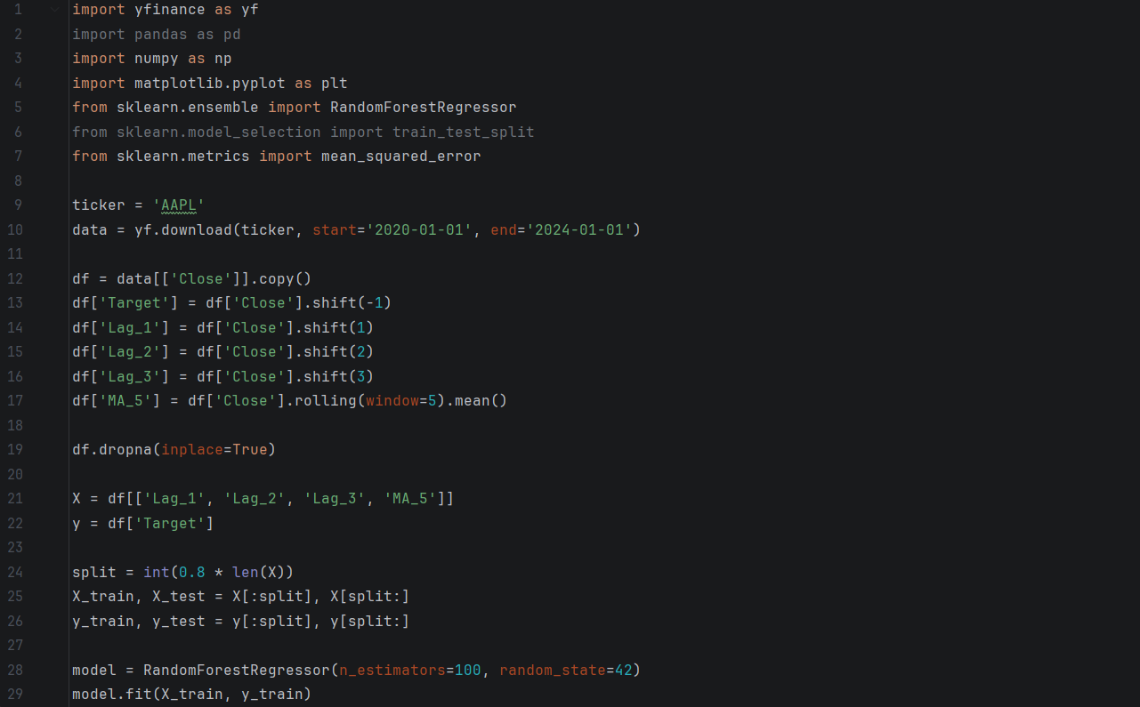
CODE

Slide 9
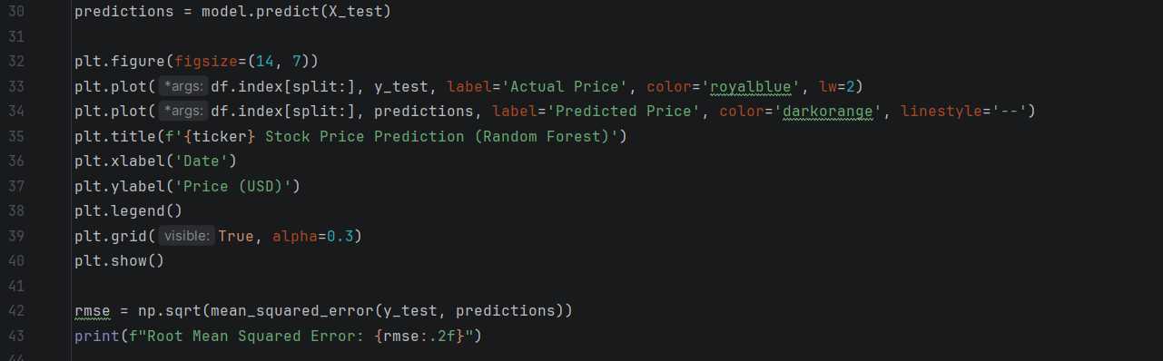

Slide 10
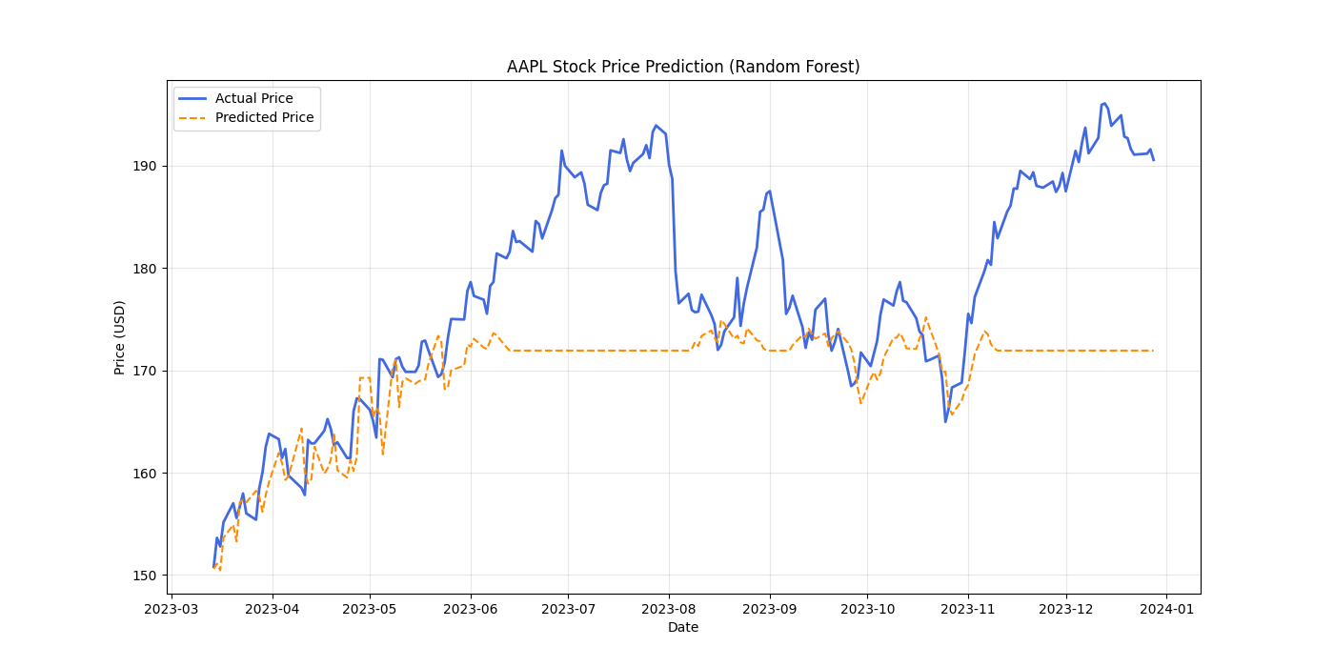
CODE OUTPUT :
1. The "Horizontal Line" Problem
The most striking feature is the flat orange dashed lines (around $172).
Why it happens: Random Forest Regressors are built using Decision Trees. A key limitation of decision trees is that they cannot predict values outside the range of the training data they have already seen.
The Result: If the stock price rises to a new all-time high that wasn't in the training set, the model "plateaus." It simply returns the average of the highest values it knows, resulting in those long, flat horizontal predictions.
2. Lagging and Mean Reversion
In the middle section (August to October), the predicted price (orange) appears to "hug" a specific narrow range even when the actual price (blue) swings wildly.
The model is likely relying on features that don't have enough predictive power for future price movements.
Instead of "forecasting," the model is essentially guessing the historical average of the data points it was trained on.
3. Lack of Extrapolation
Unlike a Linear Regression model, which can follow a trend line up to infinity, a Random Forest is an ensemble of "step functions."
It is excellent at finding patterns within a known range (interpolation).
It is notoriously bad at predicting a trend that continues upward or downward beyond its training window (extrapolation).

Slide 11
THANK YOU

